Slide 1


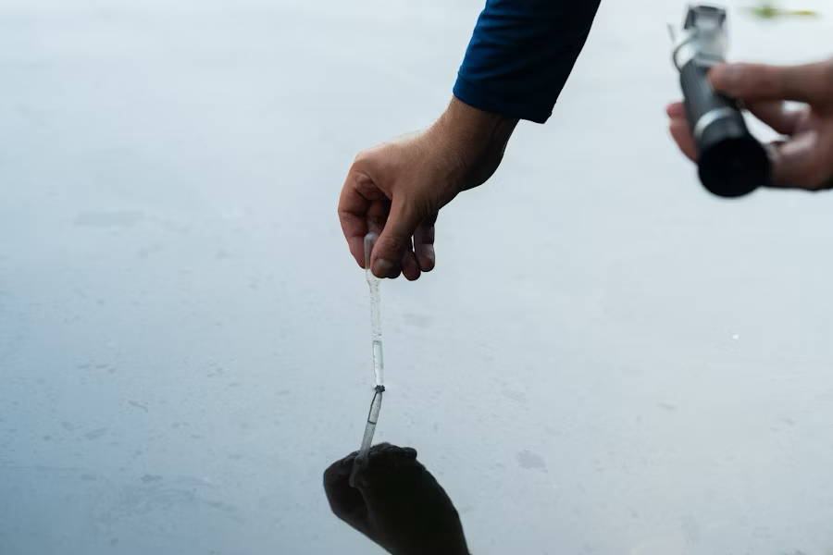
AquaTrack IoT-AI Integrated Water Quality Monitoring System
Under Supervision of:
Dr. Chinmaya Panigrahy
BE FOURTH Year
CPG25_17
Computer Science and Engineering Department
Thapar Institute of Engineering and Technology, Patiala
JUNE 2025
Team members :
Vimlendu Sharma (102166004)
Pareesh Sharma (102116092)
Vinayak Lal (102116050)
Krishma Kansal (102118054)
Piya Bhalla (102103233)

Slide 2
Problem Definition, Project Scope, and Objectives
Problem Definition
Access to clean water is essential, yet many communities still rely on outdated, manual testing methods that are slow, costly, and require lab facilities. These systems lack real-time monitoring and predictive intelligence, making them ineffective for timely responses to contamination. There is a critical need for a portable, intelligent solution that provides continuous, accurate water quality data.
Project Scope
This project aims to develop a compact, USB powered water quality monitoring system that integrates IoT sensors and AI-based prediction. It will measure key water parameters like pH, turbidity, TDS, and temperature in real time, stream data via a web dashboard, and use machine learning models to predict contamination risks. The system is designed to be affordable, scalable, and suitable for remote or resource-constrained areas, supporting environmental and public health initiatives.

Slide 3
Problem Definition, Project Scope, and Objectives contd..
Approved Objectives
Real-Time Monitoring: Continuously measure pH, turbidity, and TDS using sensor-equipped hardware.
AI-Based Prediction: Use ML models to predict Water Quality Index (WQI) and contamination risk.
Scalable & Affordable: Design cost-effective systems suitable for remote deployment.
Multi-Sensor Integration: Support multiple water parameters through modular sensor setup.
User-Friendly Interface: Design an intuitive web dashboard for easy data access and control.

Slide 4
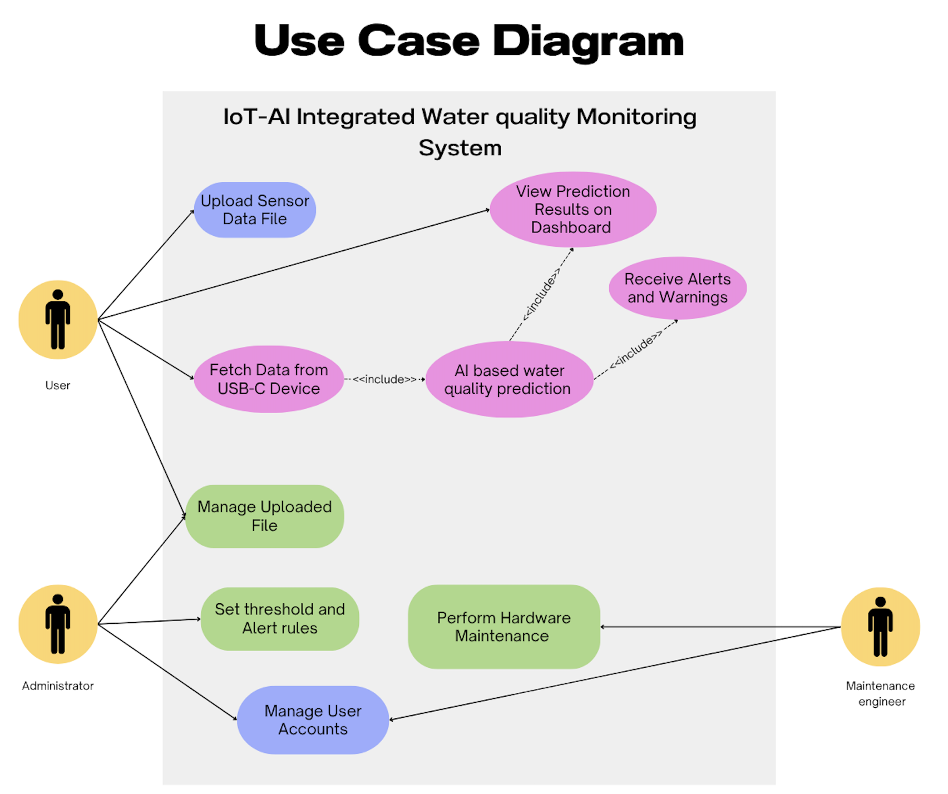
Project Analysis and Design
UML Diagrams
Fig :- Use Case Diagram

Slide 5
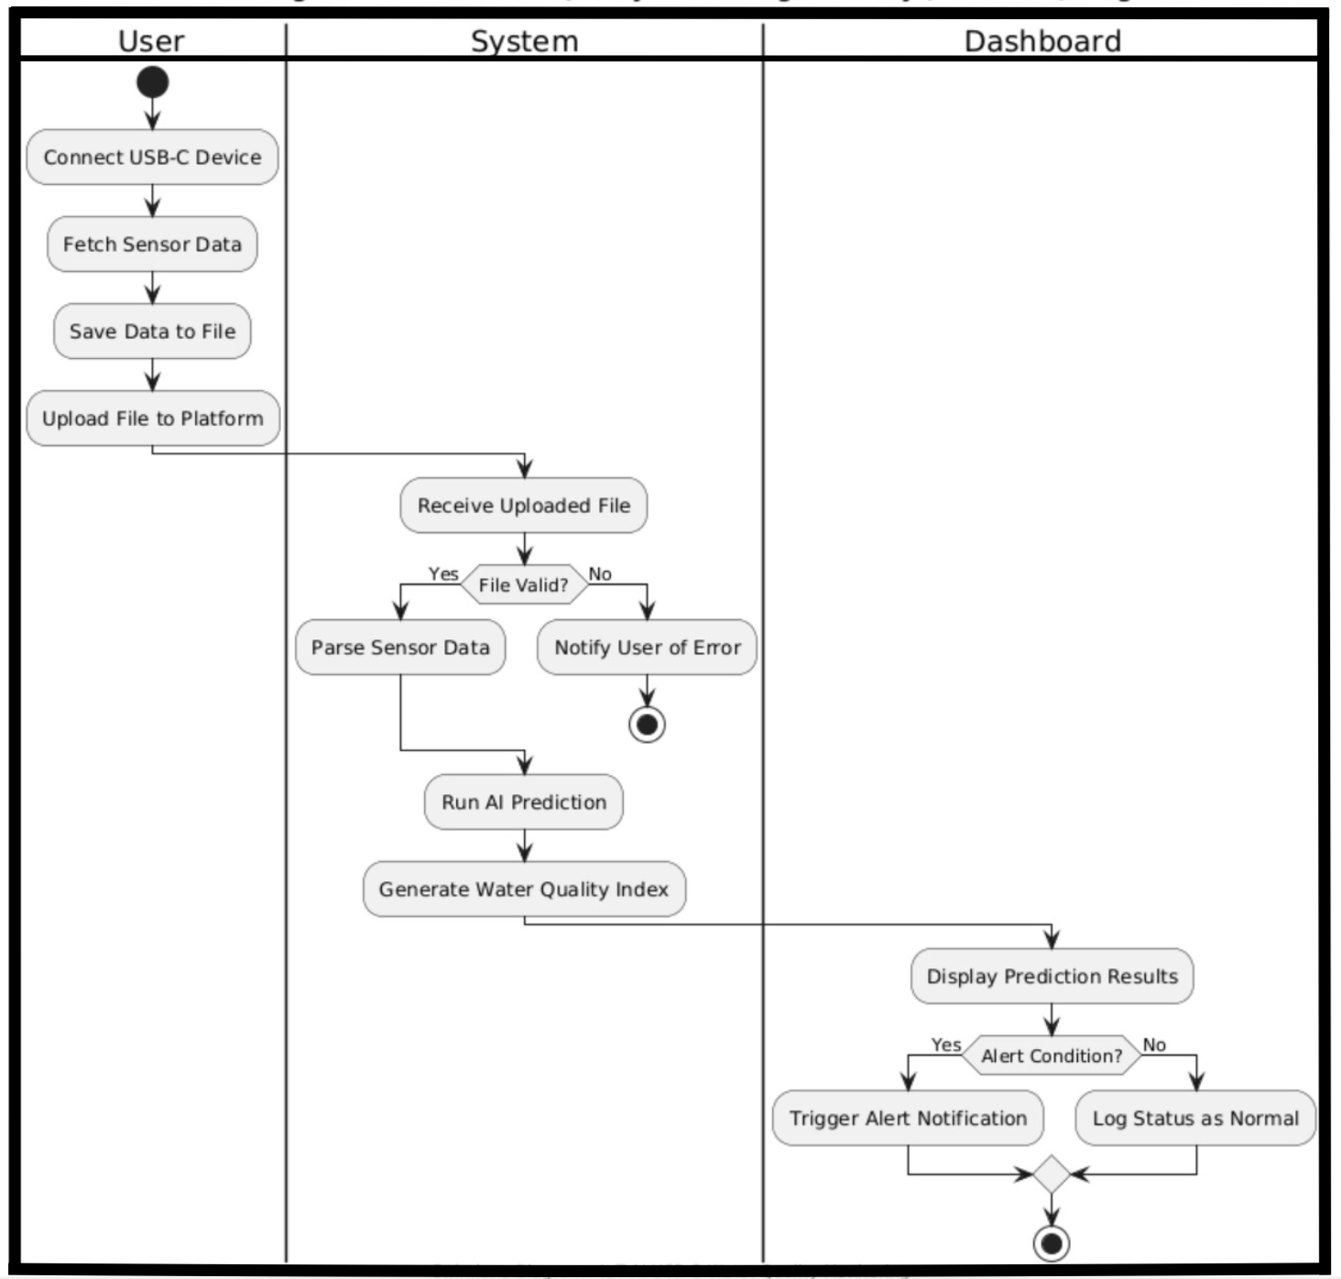
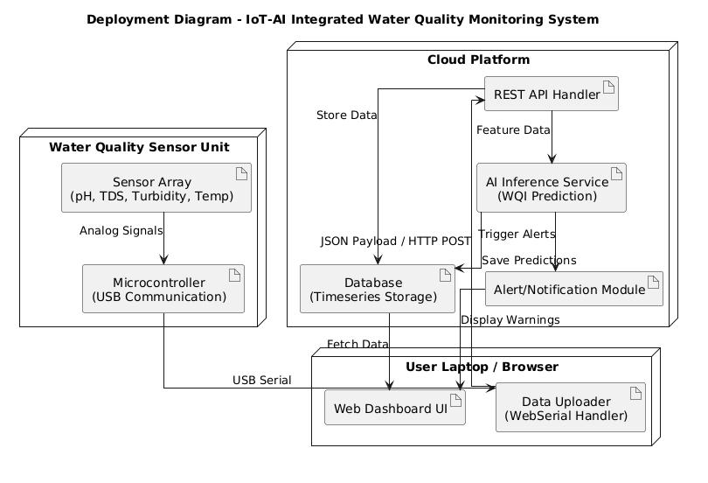
Project Analysis and Design Contd..
Fig :- Deployment Diagram
Fig :- Swimlane Diagram

Slide 6
Literature survey
S. No. | Title | Approaches | Limitations
1. | IoT-Based Real-Time Water Quality Monitoring https://doi.org/10.1016/j.matpr.2020.10.649 | Utilized sensors (pH, turbidity, temperature) connected, to monitor water in real time. | Lacks predictive intelligence; only provides raw data or threshold-based alerts.
2. | AI for Water Contamination Detection https://doi.org/10.1109/ICICCS51141.2021.9432135 | Applied machine learning models like XGBoost to analyze multi-sensor data and classify water quality. | Models often trained on static datasets; performance may drop in real-world noisy or drifting data.
3. | Web-Enabled Smart Water Monitoring Systems https://doi.org/10.1109/ic-ETITE47903.2020.193 | Used cloud dashboards and APIs for visualizing sensor data and generating user alerts. | Many systems rely on costly proprietary platforms and offer limited offline functionality.
4. | Low-Cost Sensor Integration for Water Testing https://doi.org/10.1109/ICIEM54221.2022.9852814 | Combined pH, EC, turbidity, and temperature sensors with microcontrollers (e.g., Arduino/ESP32). | Calibration drift over time and lack of robustness in harsh environments.
5. | Time-Series Forecasting of Water Quality Index https://doi.org/10.1007/s12652-023-04093-y | Leveraged historical trends and statistical features to forecast WQI using ML algorithms. | Fails to capture real-time anomalies or abrupt contaminations without frequent retraining.
6. | Edge-Based Water Monitoring with Embedded ML https://doi.org/10.1109/ACCESS.2022.3147154 | Deployed lightweight ML models on microcontrollers for offline prediction and decision-making. | Limited by low compute power and memory; requires careful model optimization.

Slide 7
Detailed Design
Tools/Platforms Used
Firmware: C/C++ (pico-sdk, TinyUSB)
ML/AI: Python, XGBoost, ONNX, MLflow
Backend: FastAPI, TimescaleDB, Celery
Frontend: React.js, WebSerial API, WebSocket
Data Processing: Pandas, OpenCV
Deployment: Docker, Kubernetes, GitHub

Slide 8
Detailed Design Contd..
Architecture Overview:
Frontend: React-based real-time dashboard
Backend API: FastAPI with TimescaleDB
Firmware: Embedded C with serial protocol (USB)
AI Service: ONNX model served via FastAPI endpoint
Streaming: WebSerial to Browser, WebSocket from API

Slide 9
Cost Analysis
Sr No. | Component | Quantity | Unit Price (₹)
1 | pH Sensor | 1 | 1700.00
2 | ESP32 (30-pin) | 1 | 320.00
3 | Turbidity Sensor | 1 | 550.00
4 | TDS Module | 1 | 600.00
5 | ADS1115 (ADC) | 1 | 200.00
6 | 1 | 1 | 100.00
TOTAL(₹) |  |  | 3470.00

Slide 10
Project Outcomes
1. Real-Time Multi-Parameter Monitoring: Successfully built a USB-powered device capable of continuously monitoring key water quality parameters — pH, turbidity, TDS, and temperature — in real time.
2. AI-Based Water Quality Prediction : Integrated a machine learning model (XGBoost) to predict water safety and detect contamination risks, providing early warning capabilities.
3. Secure and Scalable Backend: Implemented a FastAPI backend with TimescaleDB and JWT-based security, capable of scaling and supporting multiple users simultaneously.
4. Low-Cost, Modular Architecture: Designed the system using affordable components (< Rs 5000), making it viable for rural and resource-limited environments.
5. Intuitive User Interface : Designed a clean and user-friendly interface to simplify interaction for non-technical users, ensuring clarity in data interpretation and alerts.

Slide 11
Individual Contributions
1. Vimlendu Sharma (ML Modeling & System Integration): Responsible for training ML models and integrating the hardware data stream with the software pipeline.
2. Pareesh Sharma (Frontend & Hardware Interface): Responsible for developing web dashboard and hardware connections.
3. Vinayak Lal (Backend Development): Built and deployed a secure, scalable backend with real-time data ingestion.
4. Krishma Kansal (Data Handling & AI Services): Managed end-to-end data flow and embedded AI models into the system for real-time contamination prediction.
5. Piya Bhalla (Data Preprocessing & Documentation): Handled data preprocessing, and maintained detailed technical documentation.

Slide 12
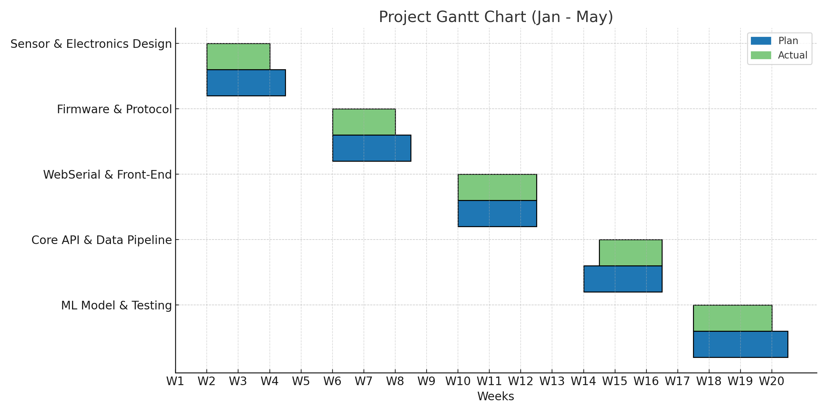
Current Progress
Gantt chart

Slide 13
Future Work Plan
1. On-device ML Inference: Shift prediction to edge using optimised ONNX model.
2. Mobile App Support: Native app with Bluetooth/OTG support
3. Expanded Sensor Suite: Add DO, nitrates, heavy metals
4. Community Deployment: Pilot testing in rural and urban field locations
5. Data Analytics Dashboard: Trend prediction and event forecasting

Slide 14
THANK YOU

